Slide 1


NATURAL LANGUAGE INFERENCE
PROJECT
REPORT
- Jay Vipin Jajoo

Slide 2

PROJECT OVERVIEW
This project explores Natural Language Inference (NLI) on the ANLI Round 2 dataset, where models classify premise-hypothesis pairs as entailment, neutral, or contradiction.
The methodology progresses through three stages:
(1) Exploratory data analysis of text lengths, word overlaps, and label distributions.
(2) Traditional ML baselines using TF-IDF features with Logistic Regression, Random Forest, and XGBoost; and
(3) Deep learning approaches with pre-trained transformers and fine-tuned BERT and DeBERTa models, enhanced with Chain-of-Thought prompting.
A modular, production-ready pipeline was developed to automate data loading, training, evaluation, and comparison across models.

Slide 3

1. EDA
METHODOLOGY
This exploratory analysis was performed to understand the characteristics of the ANLI R2 dataset before modeling. Examining feature distributions, text lengths, label balance, and word overlap between premises and hypotheses helps to:
Identify patterns and trends across different labels.
Detect anomalies or inconsistencies, such as missing values or duplicate samples.
Understand semantic relationships between premise and hypothesis using similarity measures (Jaccard and TF-IDF cosine similarity).
Highlight label-specific cues, like frequently occurring words, to inform feature engineering and preprocessing.
Visualize distributions and similarities to guide data-driven modeling decisions.

Slide 4
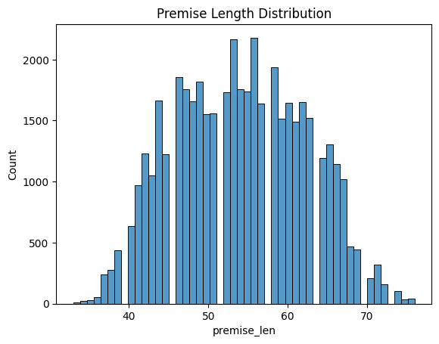
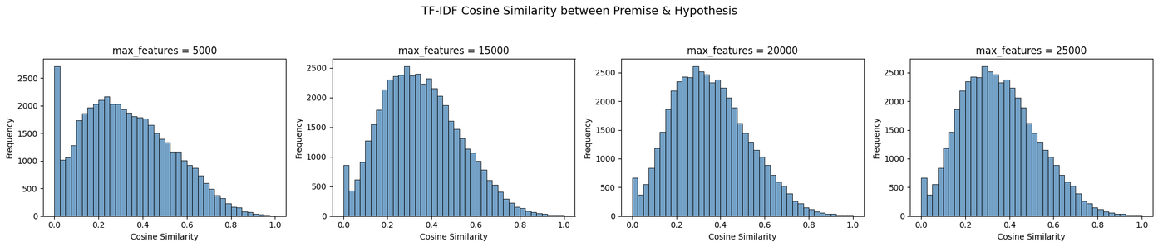
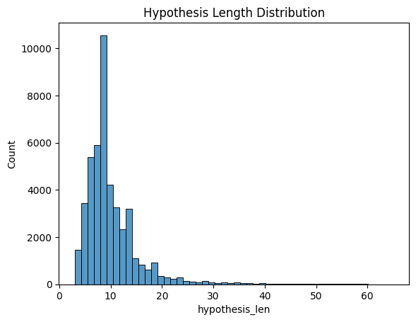
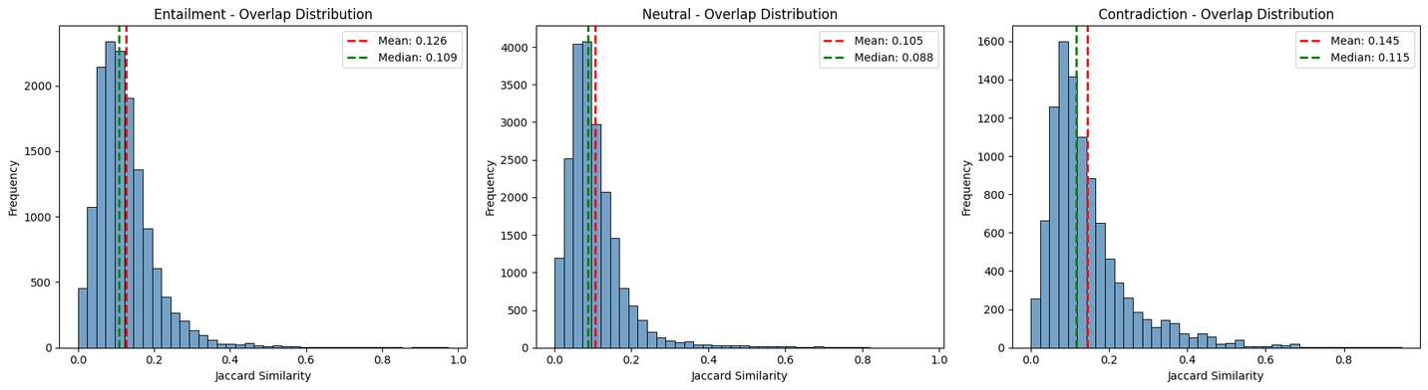
TEXT LENGTH ANALYSIS
COSINE SIMILARITY DISTRIBUTION BASED ON MAX_FEATURES
The label distribution reveals a class imbalance in the dataset: neutral samples (label 1) are the most frequent at 46.1%, entailment (label 0) make up 31.8%, and contradiction (label 2) are the least frequent at 22.1%. This imbalance could affect model training, as the model may be biased toward predicting the more common classes.
JACCARD SIMILARITY DISTRIBUTION PER LABEL

Slide 5


EDA SUMMARIZATION
The EDA shows that ANLI R2 premises are long (~50 words) while hypotheses are much shorter (~10 words), making 256-token inputs sufficient. TF-IDF cosine similarity across different feature sizes (~15K optimal) is moderate (~0.4–0.6), indicating lexical overlap is limited. Jaccard analysis reveals very low word overlap overall (10–15%), with contradictions surprisingly having the highest overlap, highlighting that simple word matching fails. These insights explain why traditional ML struggles and why transformer-based models like BERT, which capture semantic meaning rather than surface word matches, are necessary, especially to detect contradictions where similar words convey opposite meanings.

Slide 6

TRADITIONAL MACHINE LEARNING MODELS PERFORMANCE
ANALYSIS

Slide 7
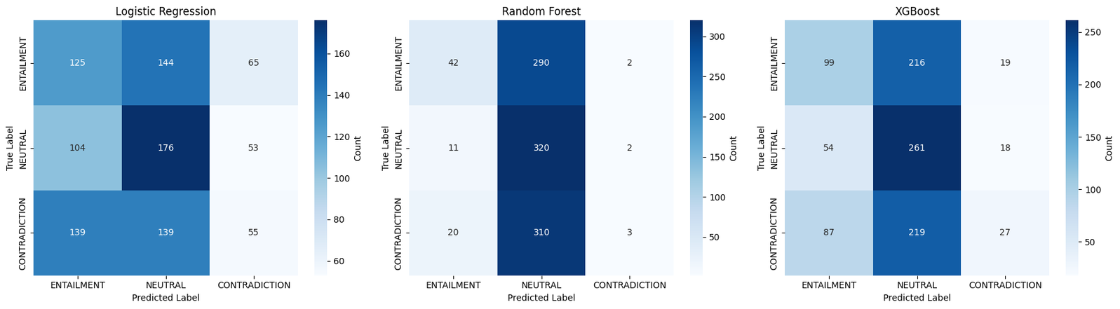
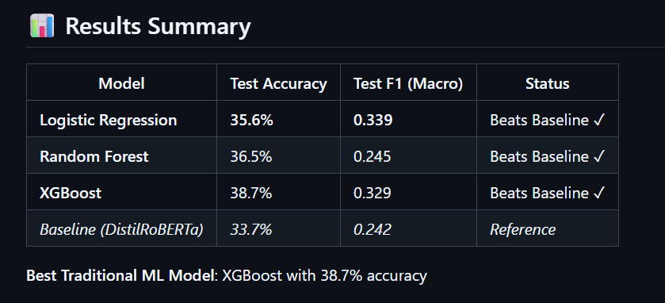
TO TRULY GAUGE A MODEL’S POTENTIAL, WE FIRST TRY TO OVERFIT IT. IF IT CAN’T EVEN CAPTURE THE TRAINING DATA (>90%), NO AMOUNT OF HYPERPARAMETER TUNING WILL MAKE IT PERFORM WELL ON NEW DATA.
All models perform poorly, with top accuracies close to random. They are biased toward ENTAILMENT and NEUTRAL, struggling to correctly predict CONTRADICTION. Even XGBoost, the best among them, shows limited ability to handle the hardest class.
`

Slide 8
WHY TRADITIONAL ML MODELS LAG BEHIND ??????.....
TF-IDF + CLASSICAL ML CAPTURES SURFACE-LEVEL FEATURES, MISSING DEEPER SEMANTIC RELATIONSHIPS
LIMITED CONTEXT UNDERSTANDING: CANNOT MODEL WORD ORDER, SYNTAX, OR LONG-RANGE DEPENDENCIES
OVERFITTING OBSERVED: TRAINING ACCURACY MUCH HIGHER THAN TEST (E.G., 72% → 36%) BUT STILL CAN’T ACHIEVE >=90% ACCURACY.
PERFORMANCE CEILING: BEST XGBOOST ONLY 38.7%, SHOWING LIMITED IMPROVEMENT OVER BASELINE
COMPUTATIONALLY EFFICIENT BUT LACKS REPRESENTATIONAL POWER FOR COMPLEX NLI PATTERNS

Slide 9

DEEP LEARNING MODELS PERFORMANCE
ANALYSIS

Slide 10
METHODOLOGY FOR BERT FINE-TUNING ON ANLI
1. Baseline Evaluation:
Started with DistilRoBERTa pre-trained on SNLI/MNLI datasets to establish a reference point.
Evaluated performance on ANLI to understand baseline accuracy (33.7%) and Macro F1 (0.242).
Baseline revealed limitations due to semantic complexity and adversarial examples.
2. BERT Fine-Tuning:
BERT-base, BERT-large and DeBERTa models were fully fine-tuned on the ANLI dataset. The training aimed to leverage BERT’s contextual embeddings to capture deeper semantic relationships that traditional ML or pre-trained smaller models miss.
Training Enhancements:
Gradient Accumulation: Simulated larger batch sizes without exceeding GPU memory.
Mixed Precision (FP16): Faster computation and reduced memory usage.
Gradient Clipping: Prevented exploding gradients during training.
Early Stopping: Monitored validation Macro F1 to avoid overfitting.
Evaluation Metrics:
Accuracy: Overall percentage of correct predictions.
Macro F1: Measures class-balanced performance; crucial since ANLI has three classes and adversarial examples can skew results.
Weighted F1: Accounts for class imbalance, providing a real-world weighted performance estimate.
Confusion Matrices: Used to inspect per-class performance, especially for challenging CONTRADICTION examples.
3. Prompt-Based Input with Chain-of-Thought (CoT):
Idea: Guide the model to reason over the premise and hypothesis in a structured manner.
Implementation: BERT-large was provided with an input prompt designed to encourage the model to “think step by step” about the semantic relationship.
Goal:
Reduce ambiguity in semantically tricky examples.
Encourage the model to leverage intermediate reasoning steps instead of relying solely on memorized patterns.

Slide 11
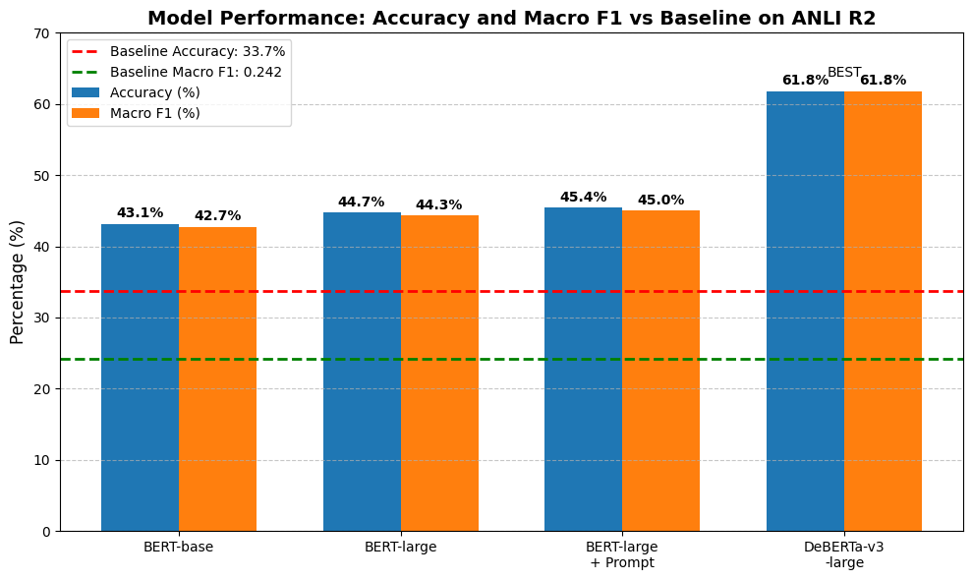

Slide 12

INSIGHTS
Fine-tuning BERT models yielded substantial improvement over the baseline (DistilRoBERTa: 33.7% acc, 0.242 F1 → BERT-large: 44.7% acc, 0.443 F1).
Larger models captured deeper semantic relationships, resulting in consistent accuracy and F1 score gains.
Prompt-based fine-tuning (BERT-large + Prompt: 45.4% acc, 0.450 F1) showed a small improvement, but analysis revealed the model mostly ignored the prompt, with gains attributed to optimization factors like learning rate scheduling and gradient accumulation.
Improvements were achieved through careful training strategies — FP16 mixed precision, gradient clipping, and early stopping.
Reproducibility (seeds, checkpoints) was key to achieving stable and comparable performance across experiments.

Slide 13
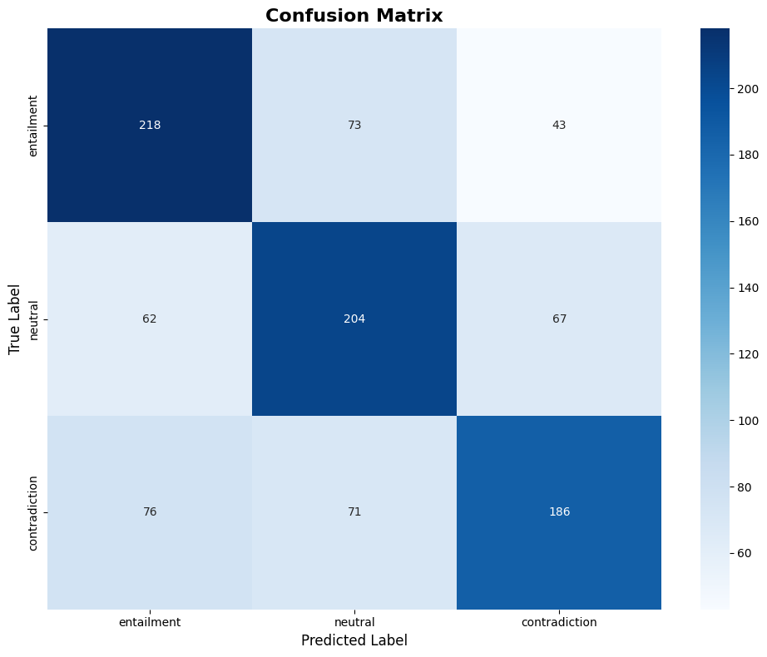
DeBERTa-v3-Large: The Breakthrough (61.8% Accuracy)
Why DeBERTa Excels (+16.4% over BERT-large):
Architecture Innovations:
✓ Disentangled Attention: Separates content & position embeddings for better contextual understanding
✓ Enhanced Mask Decoder: Improved pre-training objective (Replaced Token Detection vs Masked Language Modeling)
✓ Designed for Adversarial Robustness: Specifically handles BERT-fooling patterns that plague simpler architectures
Balanced Performance Across All Classes:
━━━━━━━━━━━━━━━━━━━━━━━
Class Precision Recall F1-Score ━━━━━━━━━━━━━━━━━━━━━━━
Entailment 0.6201 0.6647 0.6416
Neutral 0.5940 0.5976 0.5958
Contradiction 0.6417 0.5916 0.6156 ━━━━━━━━━━━━━━━━━━━━━━━
✓ Strong Generalization: Test 61.8% > Dev 61.1%
✓ No class bias despite 46.1% neutral training data
✓ Successfully overcame BERT's adversarial limitations

Slide 14
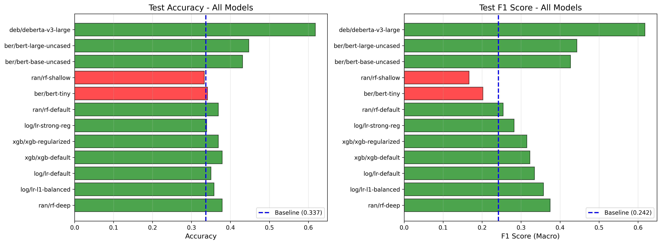
COMPARISION OF ALL MODELS
This comparison highlights the dataset's adversarial nature. Traditional ML models (XGBoost: 38.7%) and BERT variants (BERT-large: 44.7%) struggled to exceed 45% accuracy. However, DeBERTa-v3-large achieved a breakthrough with 61.8% accuracy through disentangled attention, demonstrating that advanced architectural innovations can significantly improve performance on adversarial examples while confirming ANLI remains a challenging benchmark.

Slide 15

CONCLUSION
This project demonstrated the challenges of Natural Language Inference
on the ANLI dataset, where traditional ML and BERT models struggled on adversarial examples. While BERT variants plateaued at ~45%, DeBERTa-v3-large achieved a breakthrough with 61.8% accuracy through disentangled attention architecture. Despite this 28.1 percentage point improvement over baseline, the results underscore ANLI's adversarial complexity and remaining challenges in numerical reasoning and NEUTRAL , ENTAILMENT boundaries. The progression from classical baselines (38.7%) to BERT (45.4%) to DeBERTa (61.8%) highlights that advanced architectures with enhanced contextual modeling are essential for adversarial NLI tasks.

Slide 16

ALTERNATIVE APPROACH AND RATIONALE FOR EXCLUSION
An additional idea is to train classical models on vector embeddings extracted from a fine-tuned BERT model. However, this approach is unlikely to yield strong results because classical algorithms cannot fully exploit the contextual and semantic richness encoded in BERT embeddings. Such models would treat the embeddings as static numerical features, losing the deep relational understanding between premise and hypothesis. Therefore, fine-tuning transformer-based models end-to-end remains the most effective direction for improving performance on this task.

Slide 17
Future Work
Curriculum Learning Pipeline
Strategy: Progressive pre-training on increasingly difficult NLI datasets Progression: SNLI → MNLI → FEVER-NLI → ANLI R2
Rationale: Start with simpler examples, gradually expose model to harder adversarial patterns, then fine-tune on ANLI for final robustness
Expected Impact: +5-10% accuracy → 67-70% (approaching SOTA 67-71%)

Slide 18

THANK YOU

